Slide 1
AI for .NET with SK
John Maeda and Evan Chaki

Slide 2
DESIGN THINKING
C#/.NET X COZY AI KITCHEN
Special Guest: Ben Sheppard

Slide 3
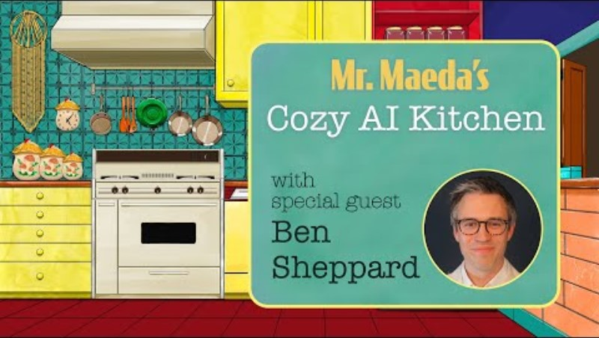

Slide 4
"Do we become authentic but simple apes in the face of AI overlords? Perhaps we APES will still have authentic leadership qualities that even the best AI will struggle to match for a while."
— Ben Sheppard via LinkedIn

Slide 5
INSTRUCTIONS
For getting cozy with this AI recipe: aka.ms/CAIK-repo

Slide 6
RECIPE FOR AI-DRIVEN DESIGN THINKING
300 tokens from Pre-trained Foundation Model 1 list of assorted customer feedback
1 ready-made "Design Thinking" PLUGIN

Slide 7
FIRE UP A KERNEL 🔥

Slide 8
SEMANTIC KERNEL!
using Microsoft.SemanticKernel;
using System;
using System.Threading.Tasks;

Slide 9
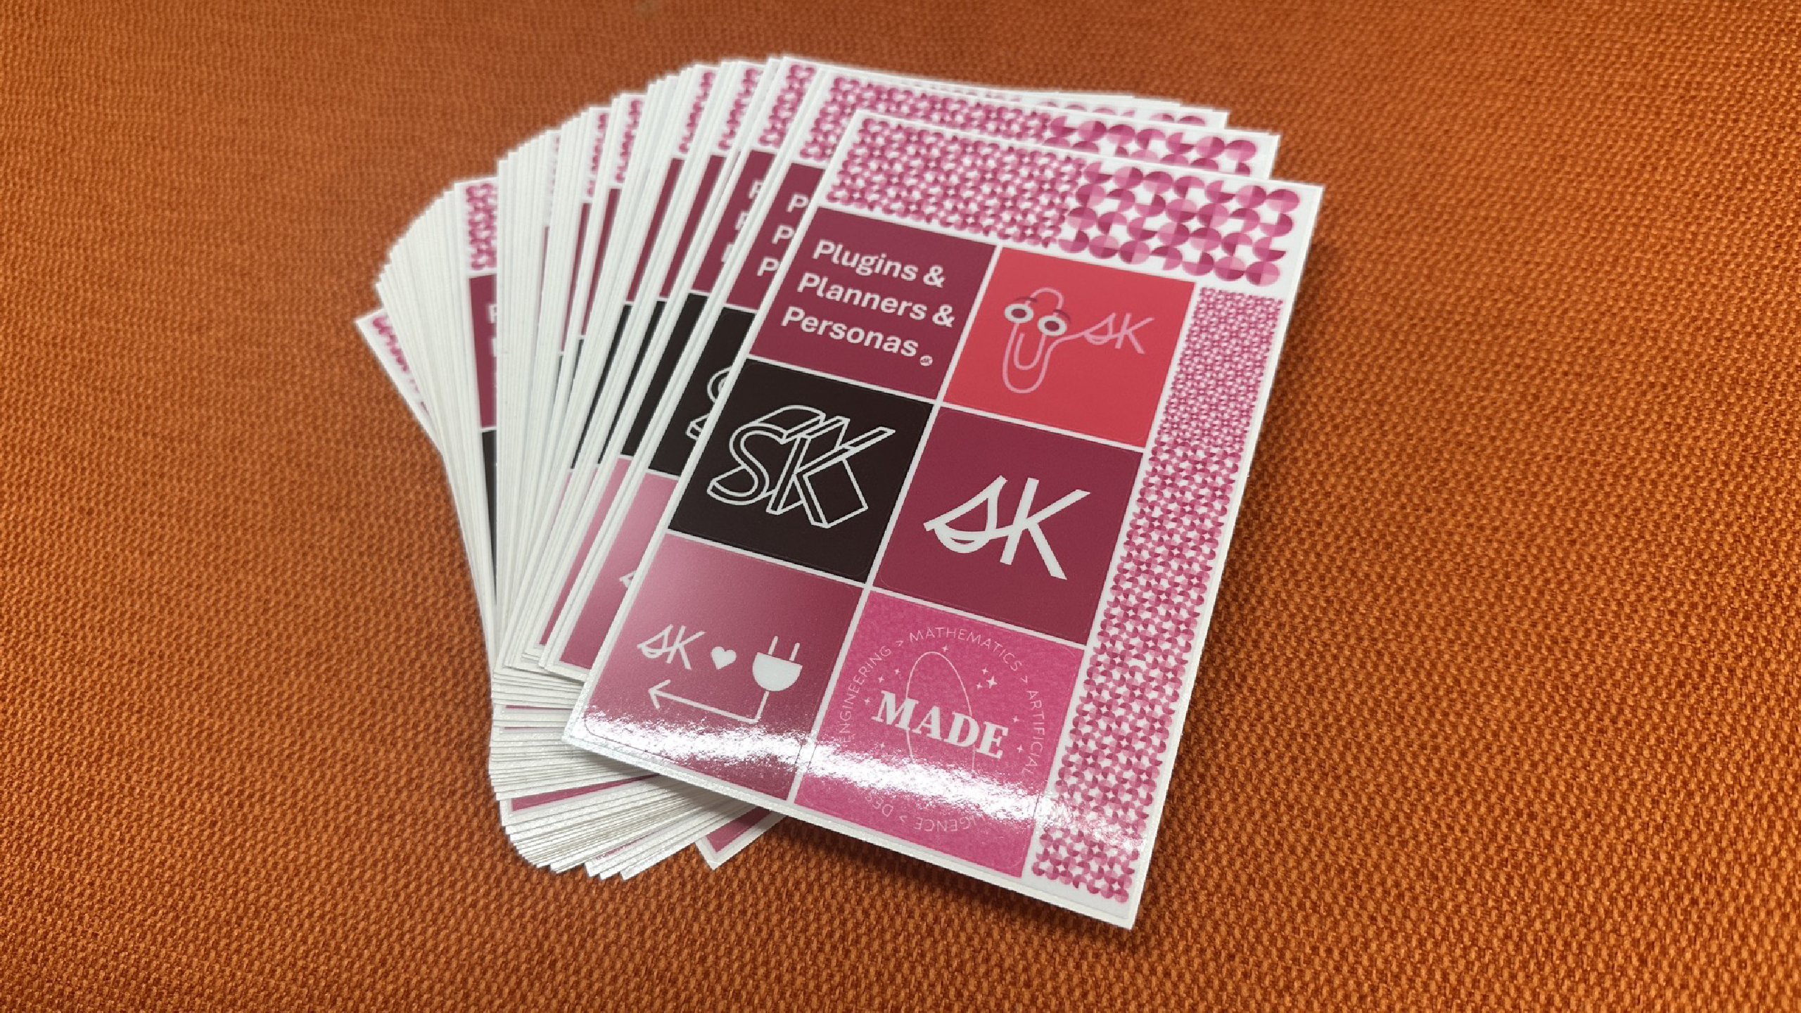


Slide 10
4
5 var builder = new KernelBuilder(); 6
7 var (useAzureOpenAI, model, azureEndpoint, apiKey, orgId) 8
9 // model = "gpt-4"; 10
11 Console.WriteLine($"Using 🧱 Model: {model}"); 12
if (useAzureOpenAI)
builder.WithAzureChatCompletionService(model, azureEn
else
16
builder.WithOpenAIChatCompletionService(model, apiKey
18 IKernel kernel = builder.Build();
17

Slide 11
USE ONE OF THE
PLUGINS 🔌

Slide 12
LOAD THE PLUGIN
1 TimeSpan startTime = TimeSpan.FromTicks(DateTime.Now.Tick 2
// Load Design Thinking Plugin
var pluginsSKDirectory = "plugins-sk";
var dtFunctions = kernel.ImportSemanticSkillFromDirectory 6
// Run the Function EmpathizeTable
var result = await dtFunctions["EmpathizeTable"].InvokeAs
@"
1. Radio won't turn on
2. Sputters due to static
3. Nice customers support people
4. No one knows how to fix it
5. Doesn't know what time it is
6 Grew up on a house boat");

Slide 13
PREP THE INPUT
6 var dtFunctions = kernel.ImportSemanticSkillFromDirectory
7
// Run the Function EmpathizeTable
var result = await dtFunctions["EmpathizeTable"].InvokeAs
@"
1. Radio won't turn on
2. Sputters due to static
3. Nice customers support people
4. No one knows how to fix it
5. Doesn't know what time it is
6. Grew up on a house boat"); 17
TimeSpan endTime = TimeSpan.FromTicks(DateTime.Now.Ticks)
TimeSpan elapsed = endTime - startTime; 20

Slide 14
PLATE THE FINISHED MEAL 🍽️

Slide 15
using Microsoft.AspNetCore.Html;
using Markdig;
var myPipeline = new MarkdownPipelineBuilder().UseAdvancedExt var myResult2HTML = Markdown.ToHtml("# How are customers feel var myHTMLContent = new HtmlContentBuilder();
myHTMLContent.AppendHtml(myResult2HTML); myHTMLContent

Slide 16
CHECK OUT THE SCIENCE OF YOUR
COOKING 🧑‍🍳

Slide 17
1 using System.Text.Json;
2
var usageresult = result.ModelResults.Select(result => re
var injson = JsonSerializer.Serialize(usageresult, new Js
Console.WriteLine($"🧱 The MODEL used:\n\n> {model}\n");
Console.WriteLine($"💸 How many TOKENS were used?\n\n{injs
Console.WriteLine($"⏰ How much TIME did it take?\n\n> {el
String functionName = "EmpathizeTable";
Console.WriteLine($"🌡 What TEMPERATURE setting was used?\
Console.WriteLine($"🙊 What TOP P setting was used?\n\n> {

Slide 18
1 using System.Text.Json;
2
var usageresult = result.ModelResults.Select(result => re
var injson = JsonSerializer.Serialize(usageresult, new Js
Console.WriteLine($"🧱 The MODEL used:\n\n> {model}\n");
Console.WriteLine($"💸 How many TOKENS were used?\n\n{injs
Console.WriteLine($"⏰ How much TIME did it take?\n\n> {el
String functionName = "EmpathizeTable";
Console.WriteLine($"🌡 What TEMPERATURE setting was used?\
Console.WriteLine($"🙊 What TOP P setting was used?\n\n> {

Slide 19
YOU MADE A DELICIOUS AI
MEAL! 🧑‍🍳

Slide 20
CAREER ADVISING
C#/.NET X COZY AI KITCHEN
Special Guest: Kevin Bethune

Slide 21
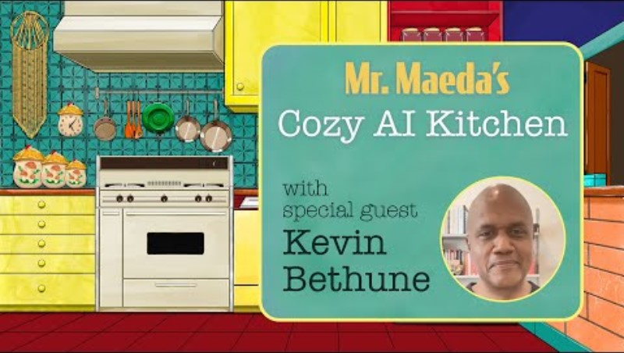

Slide 22
"We should leverage uncertainty for the powerful, creativity-inducing variable that it is."
— Kevin Bethune Reimagining Design:
Unlocking Strategic Innovation (MIT Press)

Slide 23
INSTRUCTIONS
For getting cozy with this AI recipe: aka.ms/CAIK-repo

Slide 24
RECIPE FOR AI-DRIVEN CAREER ADVISING
~500 tokens from COMPLETION Pre-trained Foundation Model
~1000 tokens from EMBEDDING Pre-trained Foundation Model
1 list of Reimagining Design quotes 1 PLUGIN for career advice

Slide 25
FIRE UP A KERNEL WITH TWO MODELS 🔥🔥

Slide 26
1 using Microsoft.SemanticKernel;
2 using Microsoft.SemanticKernel.Orchestration;
3 using Microsoft.SemanticKernel.Plugins.Memory;
4 using Microsoft.SemanticKernel.Connectors.AI.OpenAI;
5
6 var (useAzureOpenAI, model, azureEndpoint, apiKey, orgId) 7
8 var (memoryBuilder, kernelBuilder) = (new MemoryBuilder() 9
if (useAzureOpenAI)
{
memoryBuilder.WithAzureTextEmbeddingGenerationService("te
kernelBuilder.WithAzureChatCompletionService(model, azure
}
else

Slide 27
COLLECT CONTEXT WITH MEMORY
memoryBuilder.WithMemoryStore(new VolatileMemoryStore());
var (kernel, memory) = (kernelBuilder.Build(), memoryBuilder.

Slide 28
CREATE EMBEDDINGS FOR LATER
const string MemoryCollectionName = "kevinQuotes";
// Kevin quoted by his fans on GoodReads: https://www.goodrea string[] kevinQuotes = {
"I believe it’s very important to be more up-front about the "The team needs to learn how to work together, align around t "The constellation of insights must line up in a compelling w
"We should leverage uncertainty for the powerful, creativity- "The quest for innovation against newly emerging realities re
"Design still fights the perception of being the very last st
"Thanks to design thinking, most organizations are beginning "Moving on to incubation, as we build out our designed experi "Design will play an important role in stringing the collecti
};

Slide 29
HOW A QUERY WORKS
var questions = new[]
{
"create a team", "challenges of businesses"
};
foreach (var q in questions)
{
var response = await memory.SearchAsync(MemoryCollectionName, Console.WriteLine($"{q}\n> {response?.Metadata.Text}");
}

Slide 30
NOW LET'S USE A COMPLETION MODEL THAT'S
GROUNDED

Slide 31
UNGROUNDED EXAMPLE
1 var pluginsSKDirectory = "plugins-sk"; 2
3 var question = "What should I become?"; 4
5 var mnFunctions = kernel.ImportSemanticFunctionsFromDirec 6
7 var result = await kernel.RunAsync(question, mnFunctions[
8 var resultString = result.GetValue(); 9
10 Console.WriteLine($"Question: {question}\nNot-Kevin-ish A

Slide 32
MENTOR PROMPT (UNGROUNDED)
For a career advice question about:
---
{{$input}}
---
Respond succinctly as a mentor in the field of design.

Slide 33
LET'S GET GROUNDED ...
1 using Microsoft.SemanticKernel.Orchestration;
2
3 var myContext = new ContextVariables(); 4
5 var response = await memory.SearchAsync(MemoryCollectionN
6 var belief = response?.Metadata.Text; 7
8 Console.WriteLine($"Question: {question}\nBelief: {belief 9
myContext.Set("input", question);
myContext.Set("beliefs", belief);
12
var myResult = await kernel.RunAsync(myContext,mnFunction
var resultString = result.GetValue(); 15

Slide 34
GROUNDED MENTOR PLUGIN
For a career advice question about:
---
{{$input}}
---
Respond succinctly as a mentor in the field of design. Limit
---
{{$beliefs}}
---
Do not add any extra detail and stay on point. Use the contex

Slide 35
PASS THE GROUNDING FWD ...
2
3 var myContext = new ContextVariables(); 4
5 var response = await memory.SearchAsync(MemoryCollectionN
6 var belief = response?.Metadata.Text; 7
8 Console.WriteLine($"Question: {question}\nBelief: {belief 9
myContext.Set("input", question);
myContext.Set("beliefs", belief);
12
var myResult = await kernel.RunAsync(myContext,mnFunction
var resultString = result.GetValue(); 15
16 Console.WriteLine($"---\nKevin-ish Advice: {myResult}");

Slide 36
WE'RE GETTING KEVIN-ISH ...
2
3 var myContext = new ContextVariables(); 4
5 var response = await memory.SearchAsync(MemoryCollectionN
6 var belief = response?.Metadata.Text; 7
8 Console.WriteLine($"Question: {question}\nBelief: {belief 9
myContext.Set("input", question);
myContext.Set("beliefs", belief);
12
var myResult = await kernel.RunAsync(myContext,mnFunction
var resultString = result.GetValue(); 15
16 Console.WriteLine($"---\nKevin-ish Advice: {myResult}");

Slide 37
LET'S LOOK AT THE SCIENCE

Slide 38
TOKENS GET USED; HYPERPARAMETERS FTW
3 using Microsoft.SemanticKernel.AI;
4
var usageresult = myResult.FunctionResults.SelectMany(l =
var injson = JsonSerializer.Serialize(usageresult, new Js
Console.WriteLine($"🧱 The MODEL used:\n\n> {model}\n");
Console.WriteLine($"💸 How many TOKENS were used?\n\n{injs
String functionName = "CareerAdviceGrounded"; 10
var reqjson = JsonSerializer.Serialize(mnFunctions[functi
var doc = JsonDocument.Parse(reqjson);
double temperatureValue = doc.RootElement.GetProperty("te
double topPValue = doc.RootElement.GetProperty("top_p").G 15
Console.WriteLine($"🌡 What TEMPERATURE setting was used?\
Console.WriteLine($"🙊 What TOP P setting was used?\n\n> {

Slide 39
YOU MADE A DELICIOUS AI
MEAL! 🎉

Slide 40
HELLO WORLD.

Slide 41

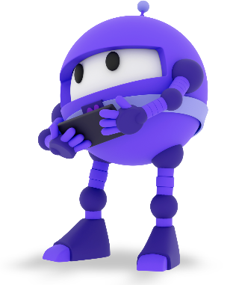
HELLO AGENTS!

Slide 42
WHAT ARE "AGENTS"?
An abstraction on top of LLM and other parts A trend that has been launched by OpenAI GPTs
They can collaborate w/ each other: "multi-agent"

Slide 43
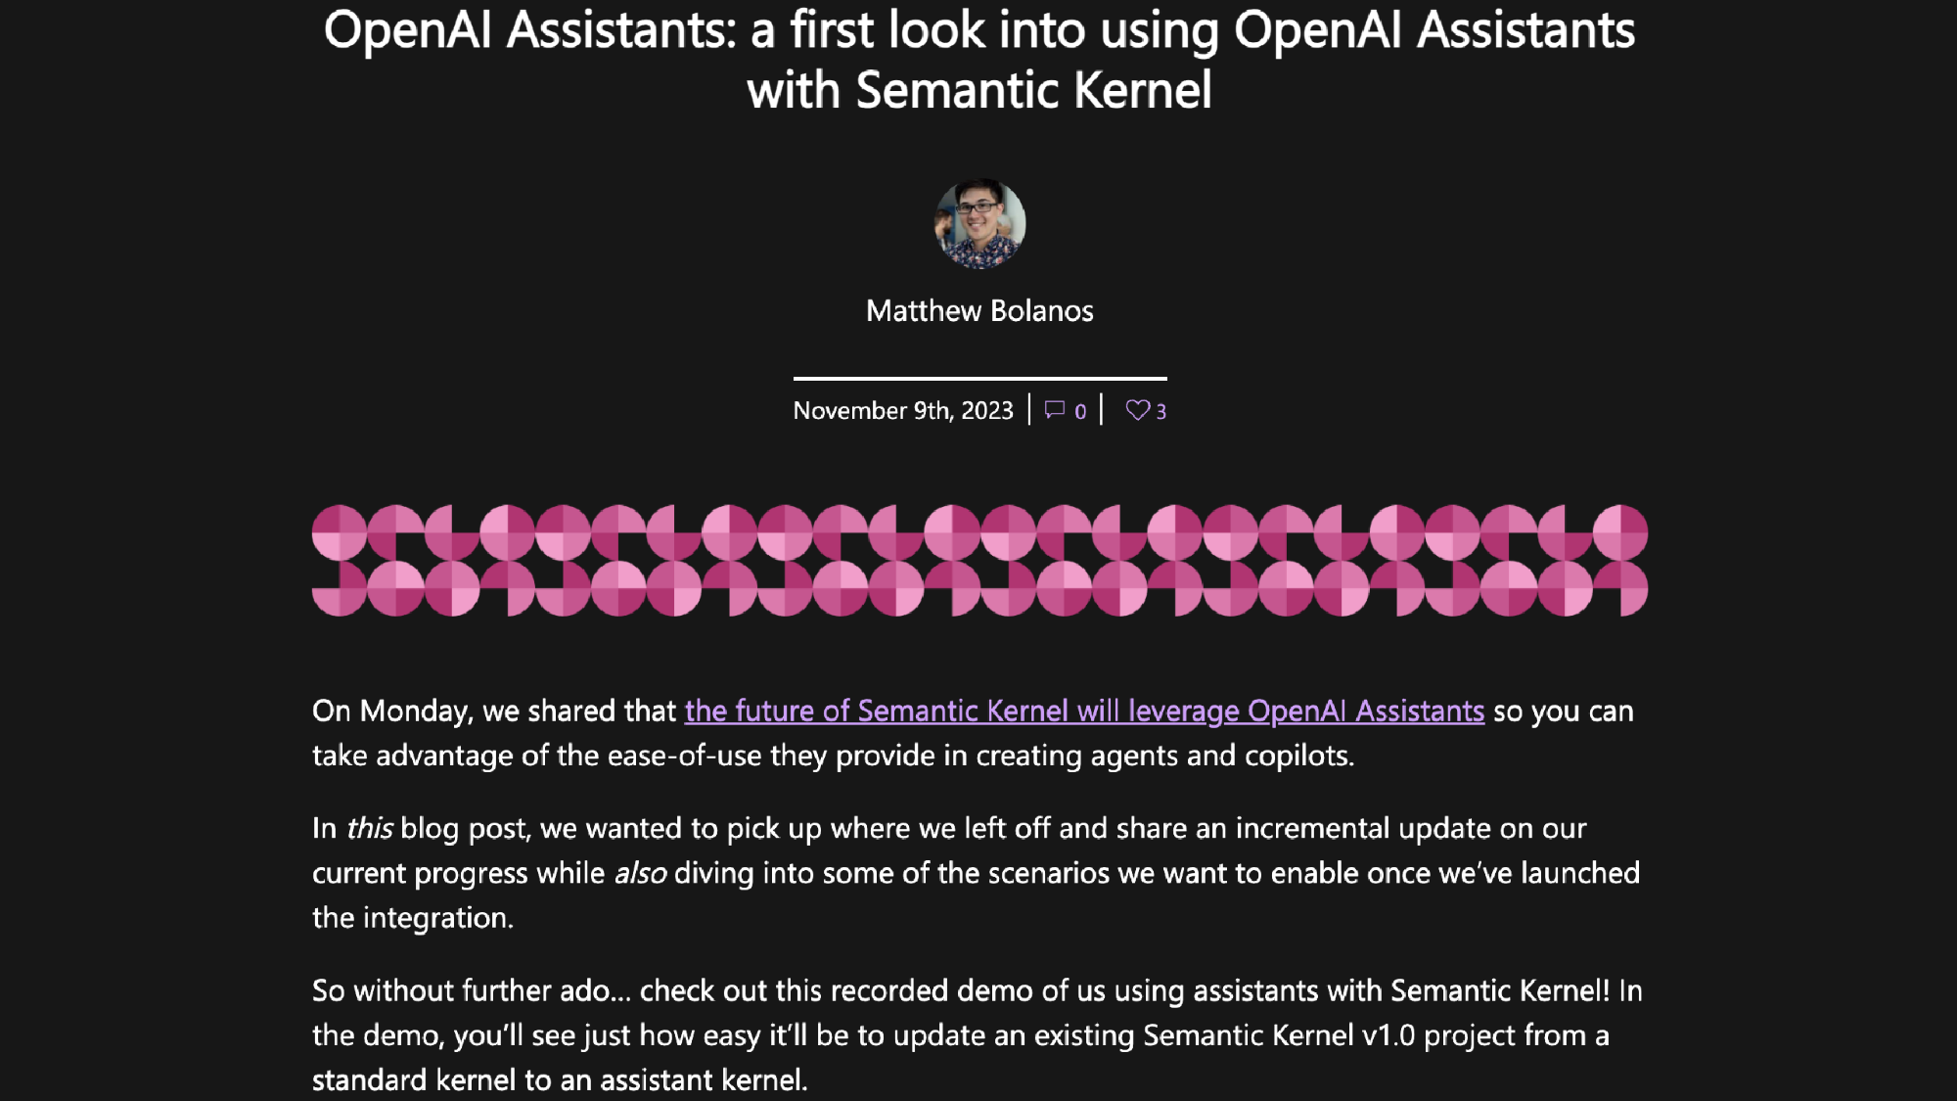

Slide 44
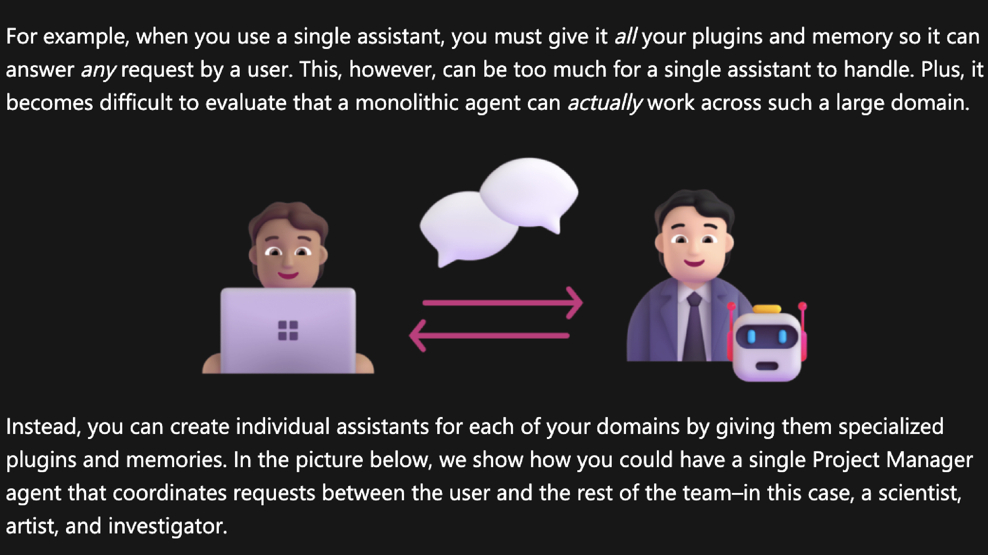
REGULAR CHAT

Slide 45
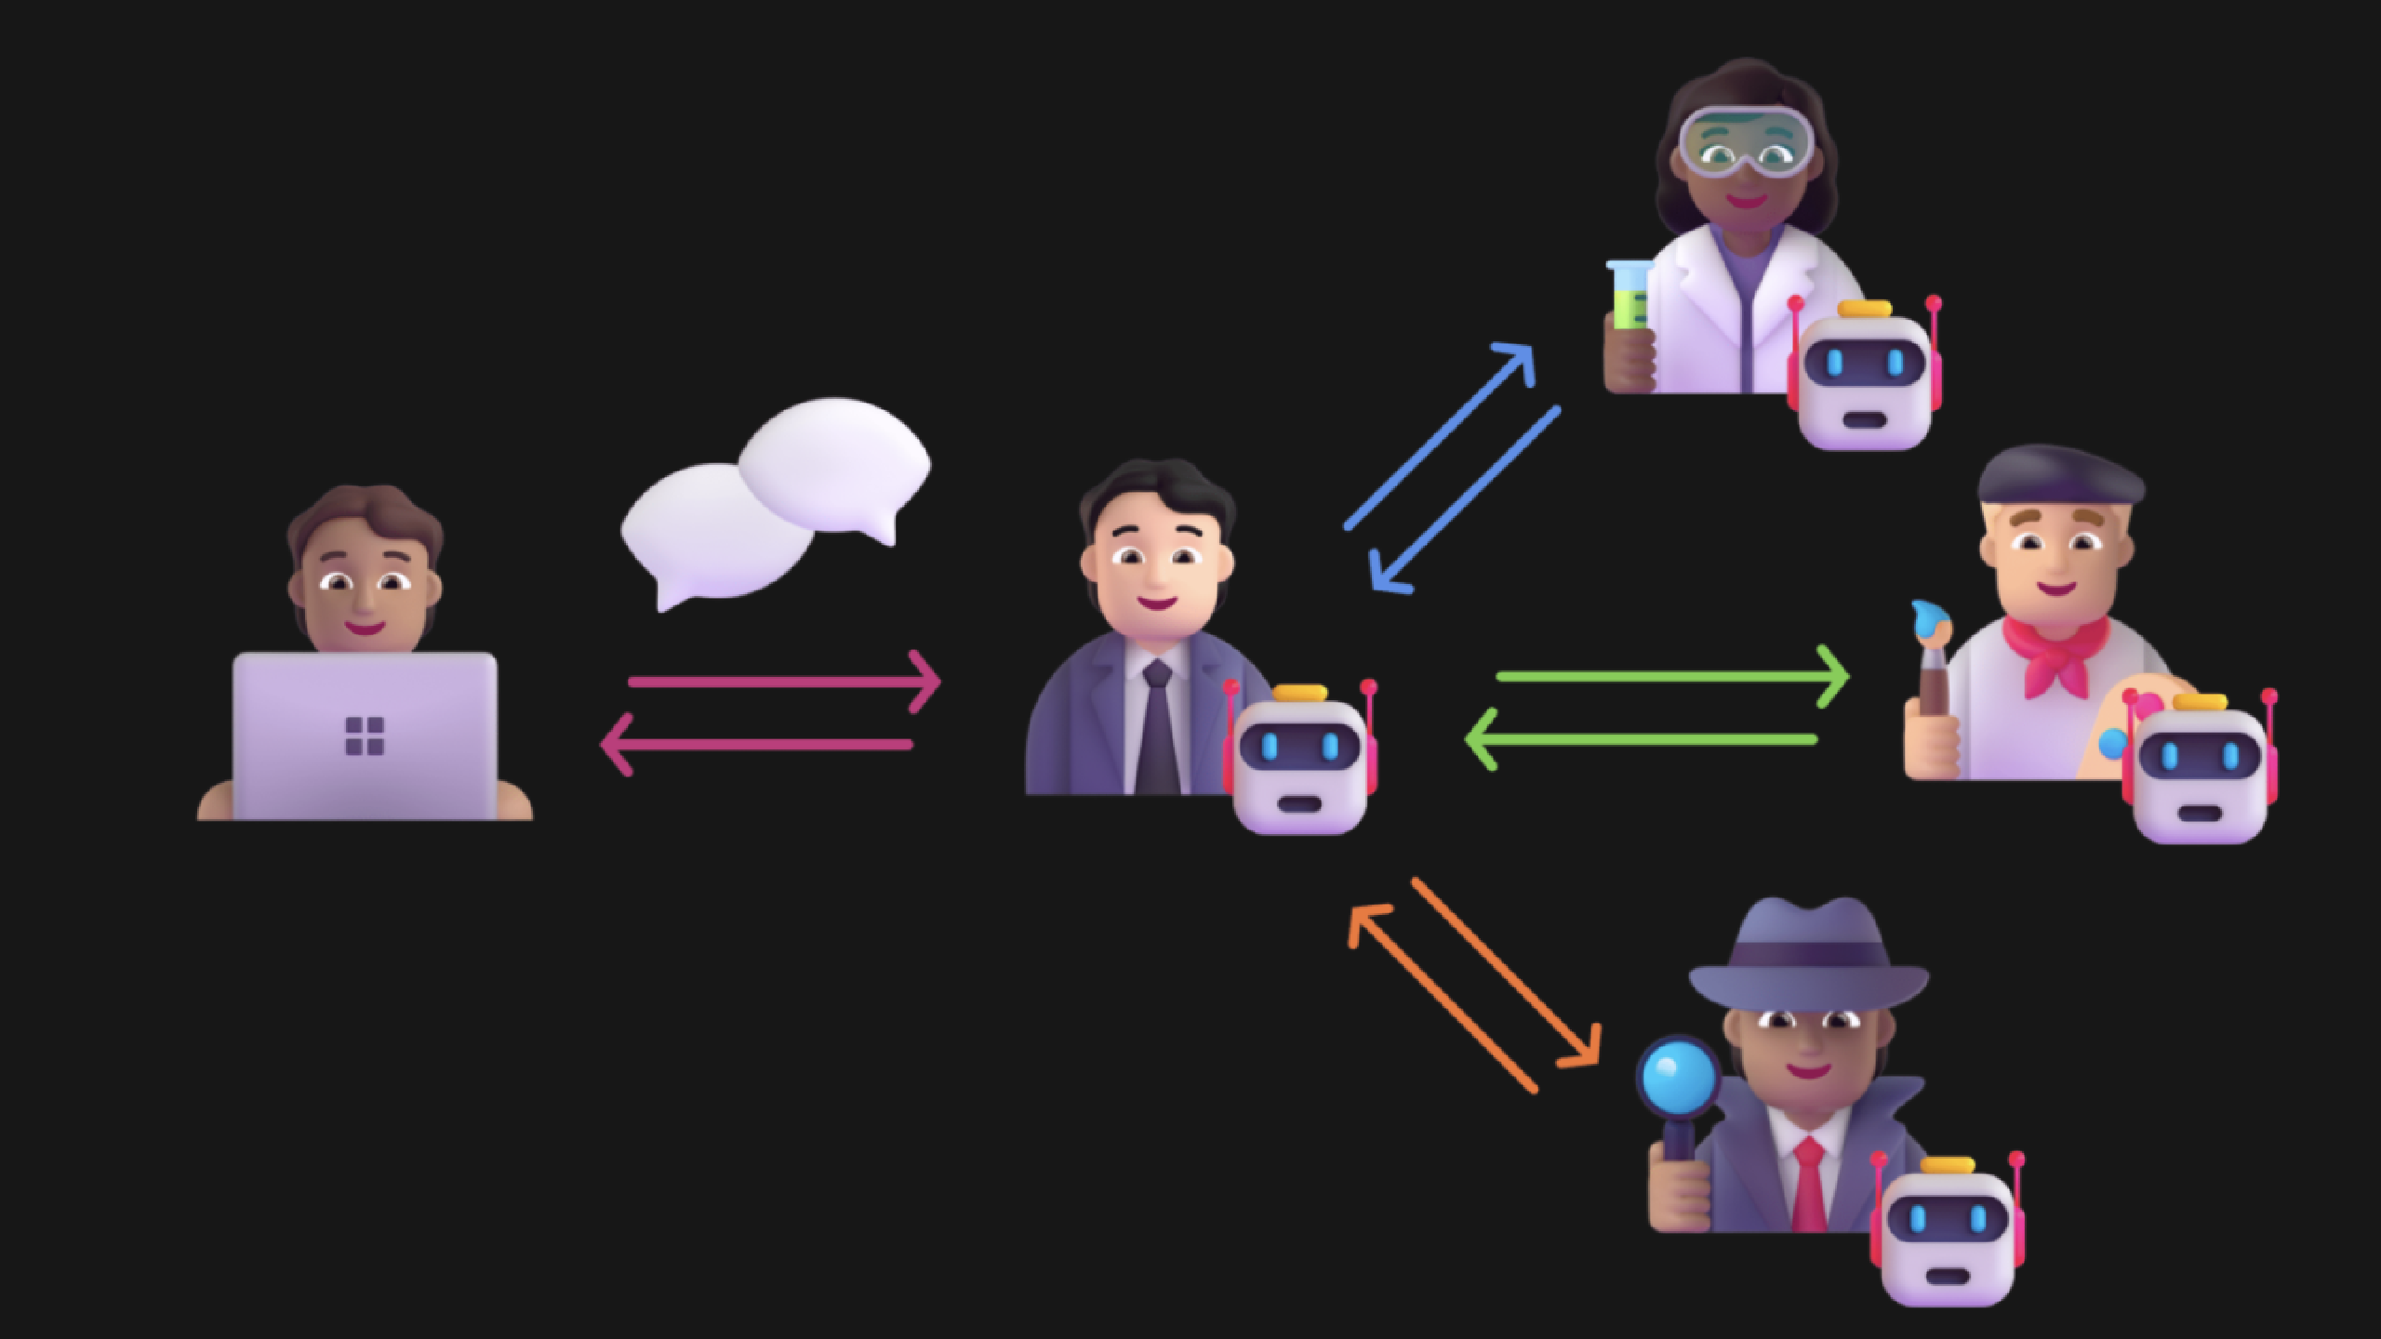
HIERARCHICAL CHAT

Slide 46
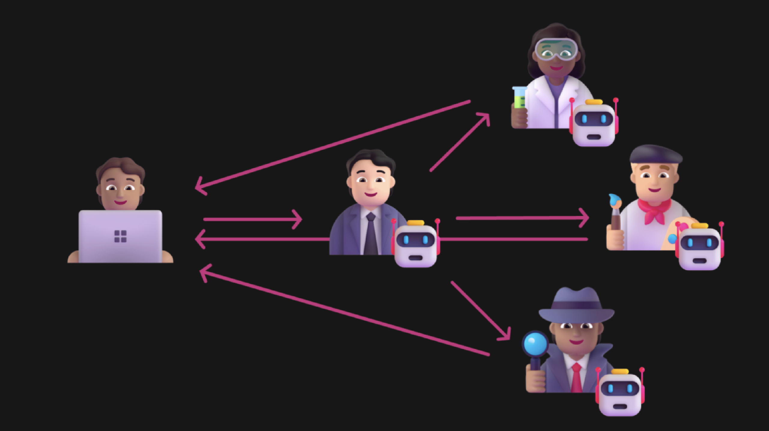
JOINT CHAT

Slide 47
STEP 1: PLUGINS
9 IChatCompletion gpt4Turbo = new OpenAIChatCompletion("gpt
10
// Create plugins
IPlugin mathPlugin = new Plugin(
name: "Math",
functions: NativeFunction.GetFunctionsFromObject(new Math
);
16
IPlugin searchPlugin = new Plugin(
name: "Search",
functions: NativeFunction.GetFunctionsFromObject(new Sear
);
21
// Create a researcher
IPlugin researcher = AssistantKernel.FromConfiguration(

Slide 48
SEARCH.CS PLUGIN
1 // Copyright (c) Microsoft. All rights reserved. 2
using System.ComponentModel;
using System.Globalization;
using System.Text.Json;
using Microsoft.Extensions.Logging;
using Microsoft.SemanticKernel;
using Microsoft.SemanticKernel.Plugins.Web.Bing;
9
public sealed class Search
{
private readonly BingConnector _bingConnector; 13
public Search(string apiKey, ILoggerFactory? loggerFactor
this(apiKey new HttpClient() loggerFactory)

Slide 49
STEP 2: ASSISTANT
name: "Search",
functions: NativeFunction.GetFunctionsFromObject(new Sear
);
21
// Create a researcher
IPlugin researcher = AssistantKernel.FromConfiguration(
currentDirectory + "/Assistants/Researcher.agent.yaml",
aiServices: new () { gpt4Turbo },
plugins: new () { searchPlugin }
);
28
// Create a mathmatician
IPlugin mathmatician = AssistantKernel.FromConfiguration(
currentDirectory + "/Assistants/Mathmatician.agent.yaml",

Slide 50
RESEARCHER.AGENT.YAML
name: Researcher
template: |
You are a researcher that searches the web for information
template_format: handlebars
description: An assistant that generates images.
execution_settings:
- model_id_pattern: ^gpt-4

Slide 51
LET'S COOK! 🧑‍🍳

Slide 52
Semantic Kernel
https://aka.ms/semantic-kernel

